Slide 1
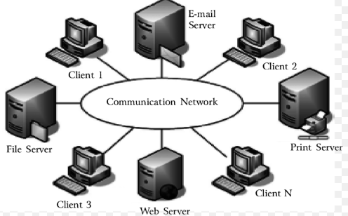
What is a Computer Network
Computer Network is a group of computers connected with each other through wires, optical fibers so that various devices can interact with each other through a network.
The aim of the computer network is the sharing of resources among various devices.

Slide 2
Features Of Computer network
Communication speed
File sharing
Security
Scalability
Reliability

Slide 3
Communication speed Network provides us to communicate over the network in a fast and efficient manner. For example, we can do video conferencing, email messaging, etc.
File sharing
File sharing is one of the major advantage of the computer network.
Security
Network allows the security by ensuring that the user has the right to access the certain files and applications.
Reliability
Computer network can use the alternative source for the data communication in case of any hardware failure.
Scalability
The measure of a system's ability to increase or decrease in performance and cost in response to changes in application and system processing demands

Slide 4
Components in Computer Networks
Network Interface Cards
Hubs
Switches
Router
Modem

Slide 5
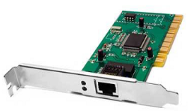
Network Interface Cards
NIC represents Network Interface Cards. A personal computer development board linked to a PC or server and works with the network control structure to force the network’s data stream. There are many network documentations that call NIC a network board. In this manner, all NICs are connected to a network

Slide 6
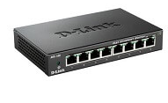
Hub
A Hub is a hardware device that divides the network connection among multiple devices. When computer requests for some information from a network, it first sends the request to the Hub through cable. Hub will broadcast this request to the entire network.

Slide 7
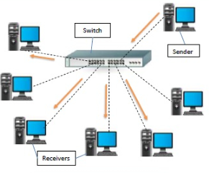
Switches
Switch is a network device that connects other devices to Ethernet networks through twisted pair cables. It uses packet switching technique to receive, store and forward data packets on the network.
The switch maintains a list of network addresses of all the devices connected to it

Slide 8
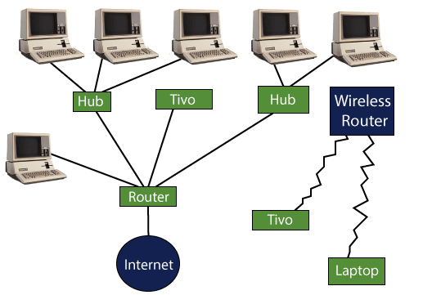
Router
The router is a physical internetworking device that is designed to receive, analyze, and forward data packets between computer networks.

Slide 9
Modem
A modem is a hardware device that allows the computer to connect to the internet over the existing telephone line.
A modem is not integrated with the motherboard rather than it is installed on the PCI slot found on the motherboard

Slide 10
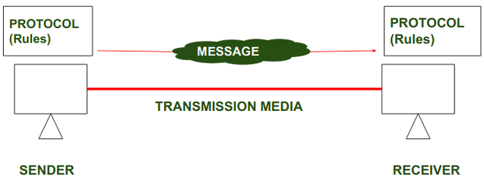
Protocol And Standards
A set of rules governing data communication is called protocol. These rules help in data communication, with connected devices and govern all aspects of information communication.
Ex: A product works and is widely used regardless of individual manufacturer. Standards provide guidelines for vendors, and manufactures, for designing a product. This leads to open and competitive market for manufacturers.

Slide 11
Data Flow Communication between two devices can be simplex, half-duplex, or full-duplex as shown in Figure
Simplex In simplex mode, the communication is unidirectional, as on a one- way street. Only one of the two devices on a link can transmit; the other can only receive (Figure a). Keyboards and traditional monitors are examples of simplex devices.
Half-Duplex
In half-duplex mode, each station can both transmit and receive, but not at the same time. When one device is sending, the other can only receive, and vice versa (Figure b). Walkie-talkies and CB (citizens band) radios are both half- duplex systems.
Full-Duplex
In full-duplex, both stations can transmit and receive simultaneously (Figure c). One common example of full-duplex communication is the telephone network. When two people are communicating by a telephone line, both can talk and listen at the same time. The full-duplex mode is used when communication in both directions is required all the time.

Slide 12
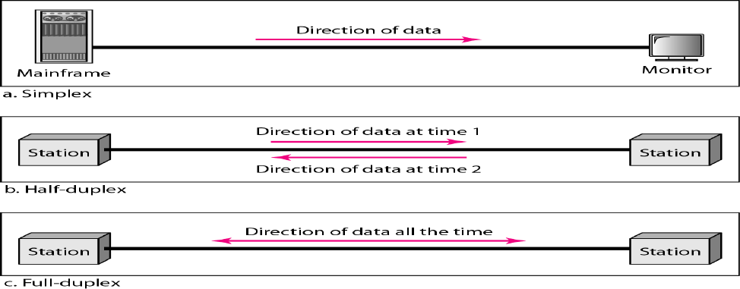

Slide 13
Network Topology It refers to the physical arrangement and representation of all the nodes and components of the network. In general terms, Topology defines the structure of the entire network. The network topology is divided into four types.
1. Bus Topology
2. Ring Topology
3. Star Topology
4. Mesh Topology

Slide 14
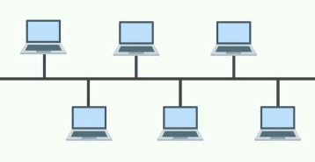
Bus Topology
In this arrangement, the nodes (computers) are connected through interface connectors to a single communication line (central cable) that carries the message in both the directions. The central cable to which all the nodes are connected is the backbone of the network. It is called a bus.
The signal in this arrangement travels in both directions to all the machines until it finds the recipient machine.

Slide 15
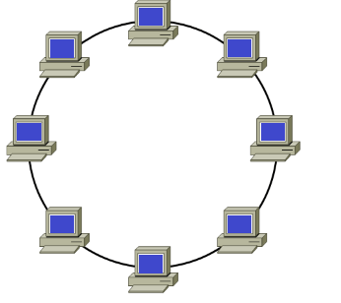
Ring Topology
As the name suggests, in a ring topology, the computers are connected in a circular and closed loop. The message in this topology moves only in one direction around the ring from one node to another node and is checked by each node for a matching destination address. So, the data keeps moving until it reaches its destination.
All nodes are equal; a client-server relationship does not exist between them.

Slide 16
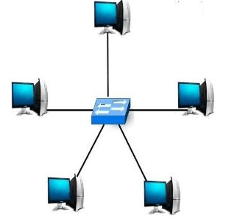
Star Topology
Star topology is a network layout in which all devices are connected to a central hub or switch. This central hub acts as a central point of communication and controls the flow of data between devices. This topology is often used in small to medium-sized networks, such as home networks or small office networks

Slide 17
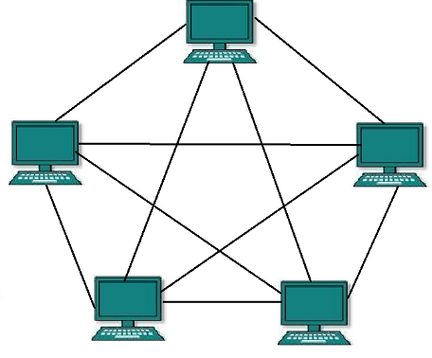
Mesh Topology
In a mesh topology, every device is connected to another device in a network using a point-to-point connection. The connection is generally known as a dedicated connection, as the link transports data between two devices. The number of links in a mesh topology is calculated using the formula below.
Military organizations use mesh topology to avoid breaks down in communications.
Many connections = n * (n - 1) /2. Here, "n" represents the number of nodes in a network.

Slide 18
Computer Network Types
Local Area Network
Personal Area Network
Metropolitan Area Network
Wide Area Network

Slide 19
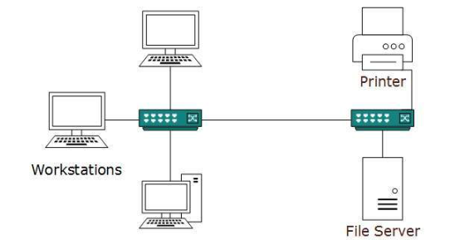
Local Area Network
A computer network spanned inside a building and operated under single administrative system is generally termed as Local Area Network (LAN). Usually,LAN covers an organization’ offices, schools, colleges or universities
LAN provides a useful way of sharing the resources between end users. The resources such as printers, file servers, scanners, and internet are easily sharable among computers.

Slide 20
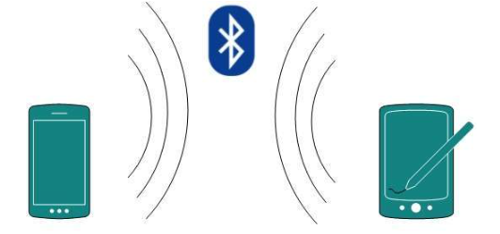
Personal Area Network
A Personal Area Network (PAN) is smallest network which is very personal to a user. This may include Bluetooth enabled devices or infra-red enabled devices. PAN has connectivity range up to 10 meters. PAN may include wireless computer keyboard and mouse, Bluetooth enabled headphones, wireless printers and TV remotes.

Slide 21
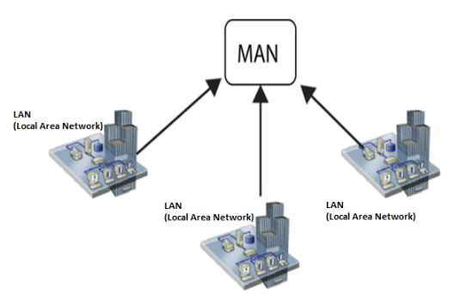
Metropolitan Area Network
Metropolitan Area Network (MAN) is an extensive network that connects numerous corporate LANs together.
Their communication devices and equipment are maintained by a group or single network provider that sells its networking services to corporate customers.
MANs often take the role of high-speed network that allows sharing of regional resources.

Slide 22
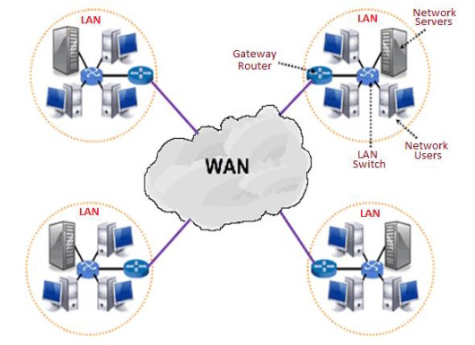
Wide Area Network
A WAN, also called the Wide Area Network, is defined as a telecommunications network that extends over a large area.
Generally, telecommunication networks are Wide Area Network. These networks provide connectivity to MANs and LANs. Since they are equipped with very high speed backbone, WANs use very expensive network equipment

